Slide 1




PDS
slido.com
Computer Vision
https://github.com/siagianp
https://www.youtube.com/@AmelOline/videos
https://github.com/amelcharolinesgn2/Cloud-Infrastructures
https://github.com/amelcharolinesgn2/ClouD-Infrastructure-SISKA-2025
https://github.com/amelcharolinesgn2/CCNA1
https://github.com/amelcharolinesgn2/CCNA2
https://github.com/amelcharolinesgn2/AWS Certificate
Notes:
Lab Session 01: AWS Compute Foundations – EC2, Networking, and Application Deployment Lab Session 02: Identity and Access Control with IAM Lab Session 03: Cloud Storage Solutions – S3, EBS, and EFS Lab Session 04: Database Services – RDS, DynamoDB, and ElastiCache Lab Session 05: Load Balancing and Auto Scaling Lab Session 06: Container Orchestration with ECS, Fargate, and EKS Lab Session 07: Serverless Computing with Lambda Lab Session 08: Monitoring, Logging, and Security Auditing Lab Session 09: Infrastructure as Code – CloudFormation, CDK, and Terraform Lab Session 10: CI/CD Pipelines – App Runner, CodePipeline, GitHub Actions, and CodeDeploy Lab Session 11: AI/ML Services – Rekognition, Comprehend, Translate, and SageMaker Lab Session 12: Hybrid Cloud Networking – VPC Peering, Transit Gateway, VPN, and Direct Connect Lab Session 13: Security and Compliance – AWS Config, GuardDuty, Security Hub, and KMS Lab Session 14: Disaster Recovery and Business Continuity – AWS Backup, Multi-Region, and Failover Lab Session 15: Migration and Modernization – DataSync, DMS, MGN, Containers, and Serverless
Lab Session 16: Cost Management and Optimization – Cost Explorer, Trusted Advisor, Budgets, and Well-Architected
https://www.youtube.com/watch?v=SOTamWNgDKc&t=19604s

Slide 2



Do not edit
How to change the design
slido.com
Presenting with animations, GIFs or speaker notes? Enable our Chrome extension
Notes:
📣 This is Slido interaction slide, please don't delete it.
✅ Click on 'Present with Slido' and the joining instructions will appear when you get to this slide.

Slide 3

Do not edit
How to change the design
How was your experience at AUST?
Presenting with animations, GIFs or speaker notes? Enable our Chrome extension
Notes:
📣 This is Slido interaction slide, please don't delete it.
✅ Click on 'Present with Slido' and the poll will launch automatically when you get to this slide.

Slide 4
Do not edit
How to change the design
What would you do if you got the chance to be readmitted in the first semester?
Presenting with animations, GIFs or speaker notes? Enable our Chrome extension
Notes:
📣 This is Slido interaction slide, please don't delete it.
✅ Click on 'Present with Slido' and the poll will launch automatically when you get to this slide.

Slide 5
Do not edit
How to change the design
If you were on the management committee, what changes would you make?
Presenting with animations, GIFs or speaker notes? Enable our Chrome extension
Notes:
📣 This is Slido interaction slide, please don't delete it.
✅ Click on 'Present with Slido' and the poll will launch automatically when you get to this slide.

Slide 6
REVISION CLASS
Cloud Computing

Slide 7

What is Cloud Computing ?
Cloud computing is the delivery of on-demand computing services—such as servers, storage, databases, networking and more—over the internet ('the cloud').
Compare cloud computing to utility services like electricity or water on-demand, scalable, and pay-as-you-go

Slide 8
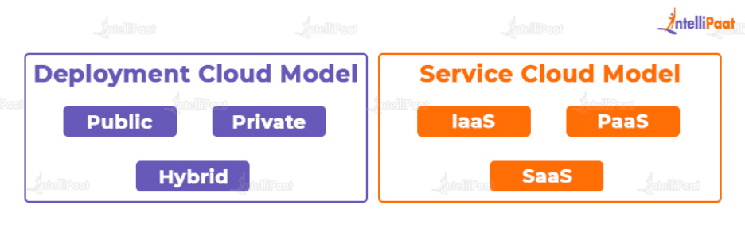
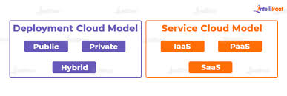
Deployment vs Service Model

Slide 9
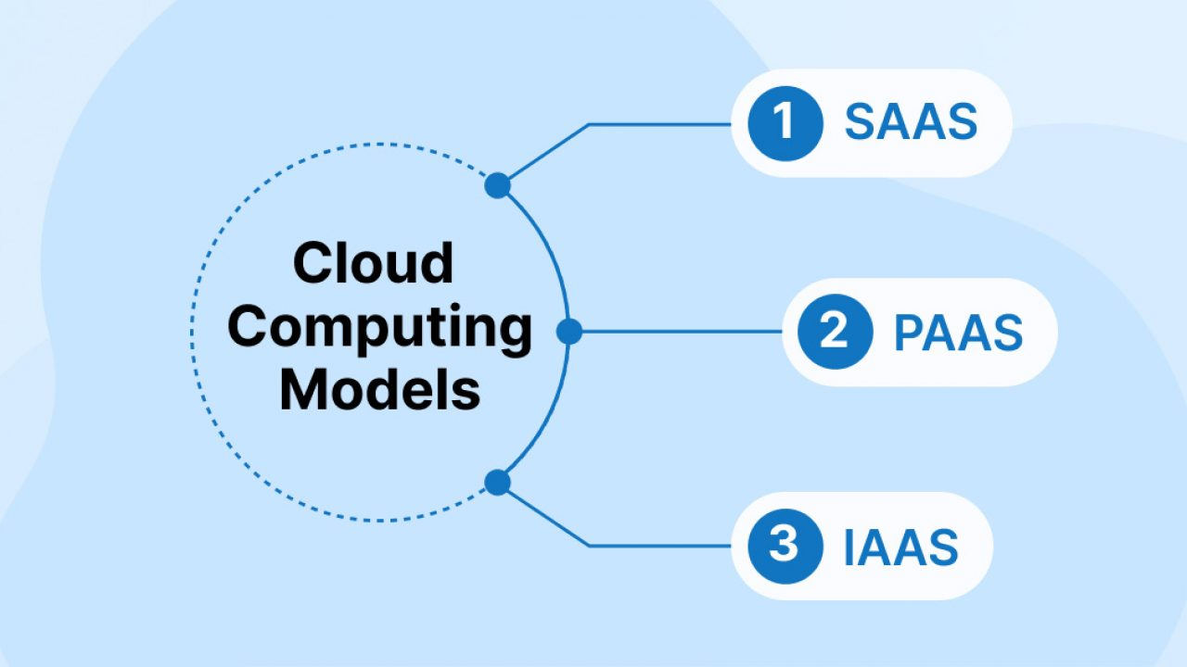
Cloud Service Models
On Premise = you buy everything and make the pizza at home
IaaS = take and bake (pick up the pizza, you cook it at home)
PaaS = pizza delivered
SaaS = dining in the restaurant

Slide 10
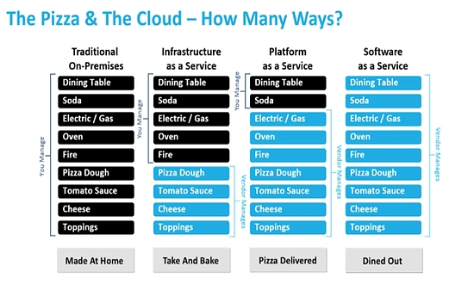

Slide 11
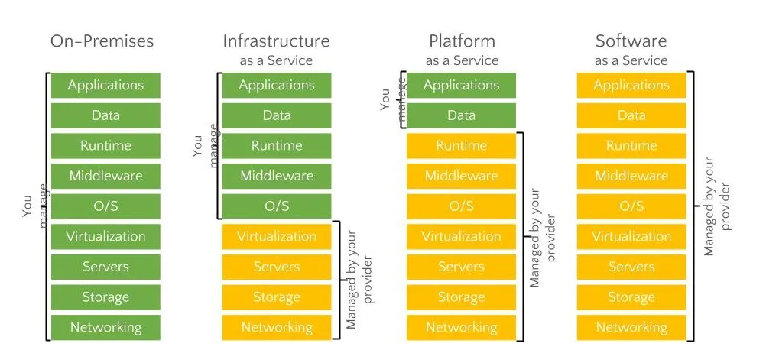
Cloud Providers Model

Slide 12

Do not edit
How to change the design
Which cloud model provides platforms for development?
Presenting with animations, GIFs or speaker notes? Enable our Chrome extension
Notes:
📣 This is Slido interaction slide, please don't delete it.
✅ Click on 'Present with Slido' and the poll will launch automatically when you get to this slide.

Slide 13
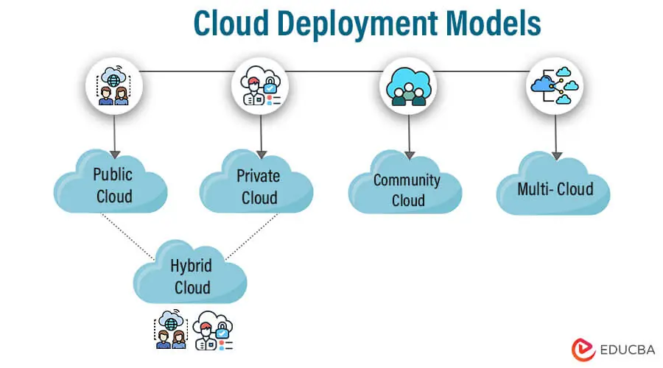
5. Cloud Deployment Models
Public Cloud: Services offered over the internet (e.g., AWS, Azure, GCP).
Private Cloud: Cloud infrastructure dedicated to a single organization.
Hybrid Cloud: Combination of public and private clouds.
Community Cloud: Shared by organizations with a common goal.

Slide 14
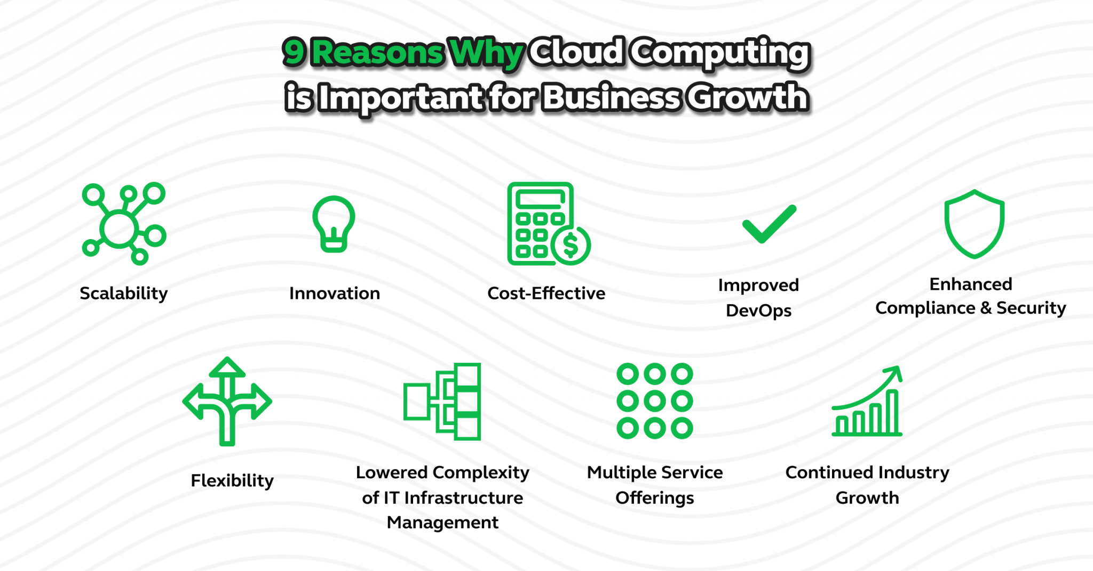
Advantages of Cloud Computing
Cost Efficiency
Scalability
Flexibility
High Availability and
Disaster Recovery

Slide 15
Do not edit
How to change the design
How does cloud computing improve scalability?
Presenting with animations, GIFs or speaker notes? Enable our Chrome extension
Notes:
📣 This is Slido interaction slide, please don't delete it.
✅ Click on 'Present with Slido' and the poll will launch automatically when you get to this slide.

Slide 16
Course Recap
Virtualization & Containerization (Docker)
Serverless Computing & API Gateways
Cloud Storage & Databases (Amazon S3, RDS)
Networking (VPC)
CDN (Amazon CloudFront)
Security & Compliance in the Cloud
Queue & Pub-Sub (Amazon SQS, SNS)

Slide 17
Virtualization & Containerization (Docker)
Virtualization: Running multiple OS instances on a single physical machine (e.g., VMware, Hyper-V).
Containerization: Lightweight, portable environments for applications (e.g., Docker, Kubernetes).
Use Cases: Microservices, DevOps, efficient resource utilization.

Slide 18
Do not edit
How to change the design
Which of the following is a containerization tool?
Presenting with animations, GIFs or speaker notes? Enable our Chrome extension
Notes:
📣 This is Slido interaction slide, please don't delete it.
✅ Click on 'Present with Slido' and the poll will launch automatically when you get to this slide.

Slide 19
Serverless Computing & API Gateways
Serverless Computing: No need to manage servers (AWS Lambda, Azure Functions).
API Gateway: Manages and secures API requests (AWS API Gateway).
Use Cases: Scalable applications, event-driven architectures.

Slide 20
Do not edit
How to change the design
Which AWS service is used to manage API requests?
Presenting with animations, GIFs or speaker notes? Enable our Chrome extension
Notes:
📣 This is Slido interaction slide, please don't delete it.
✅ Click on 'Present with Slido' and the poll will launch automatically when you get to this slide.

Slide 21
Cloud Storage & Databases (Amazon S3, RDS)
Amazon S3: Scalable object storage for files, backups, and static content.
Amazon RDS: Managed relational databases (MySQL, PostgreSQL, etc.).
Use Cases: Web applications, data analytics, disaster recovery.

Slide 22
Do not edit
How to change the design
Which AWS service is an object storage solution?
Presenting with animations, GIFs or speaker notes? Enable our Chrome extension
Notes:
📣 This is Slido interaction slide, please don't delete it.
✅ Click on 'Present with Slido' and the poll will launch automatically when you get to this slide.

Slide 23
CDN (Amazon CloudFront)
Content Delivery Network (CDN): Speeds up content delivery using global edge locations.
Amazon CloudFront: Integrates with S3, EC2, and other AWS services.
Use Cases: Website acceleration, video streaming, DDoS protection.

Slide 24
Do not edit
How to change the design
What is the main purpose of a CDN?
Presenting with animations, GIFs or speaker notes? Enable our Chrome extension
Notes:
📣 This is Slido interaction slide, please don't delete it.
✅ Click on 'Present with Slido' and the poll will launch automatically when you get to this slide.

Slide 25
Security & Compliance in the Cloud
Identity & Access Management (IAM): Controls user permissions.
Encryption: Data encryption at rest and in transit (AWS KMS, SSL/TLS).
Compliance: GDPR, ISO, HIPAA, SOC 2 for regulated industries.

Slide 26
Do not edit
How to change the design
Which AWS service is used for managing user access?
Presenting with animations, GIFs or speaker notes? Enable our Chrome extension
Notes:
📣 This is Slido interaction slide, please don't delete it.
✅ Click on 'Present with Slido' and the poll will launch automatically when you get to this slide.

Slide 27
Queue & Pub-Sub (Amazon SQS, SNS)
Amazon SQS: Message queue for decoupling applications.
Amazon SNS: Pub-sub messaging for real-time notifications.
Use Cases: Event-driven architectures, microservices communication.

Slide 28
Do not edit
How to change the design
Which AWS service is used for a message queue?
Presenting with animations, GIFs or speaker notes? Enable our Chrome extension
Notes:
📣 This is Slido interaction slide, please don't delete it.
✅ Click on 'Present with Slido' and the poll will launch automatically when you get to this slide.

Slide 29
Future Trends in Cloud Computing
AI & Machine Learning in the Cloud
Edge Computing & IoT
Multi-Cloud & Hybrid Cloud
Quantum Computing

Slide 30
Career Paths:
Cloud Engineer
DevOps Engineer
Solutions Architect
Security Specialist

Slide 31
Certifications
AWS Certified Cloud Practitioner
AWS Certified Solutions Architect
Microsoft Azure Administrator
Google Cloud Associate Engineer
Kubernetes & DevOps Certifications

Slide 32
Do not edit
How to change the design
If the election were held in 2025 in Bangladesh, which party would you vote for?
Presenting with animations, GIFs or speaker notes? Enable our Chrome extension
Notes:
📣 This is Slido interaction slide, please don't delete it.
✅ Click on 'Present with Slido' and the poll will launch automatically when you get to this slide.

Slide 33
THANK YOU
Amel charoline
Amel Online & Irene magdalena
https://github.com/siagianp
https://www.youtube.com/@AmelOline/videos
https://github.com/amelcharolinesgn2/Cloud-Infrastructures
https://github.com/amelcharolinesgn2/ClouD-Infrastructure-SISKA-2025
https://github.com/amelcharolinesgn2/CCNA1
https://github.com/amelcharolinesgn2/CCNA2
https://github.com/amelcharolinesgn2/AWS Certificate

